Slide 1
Fungi found in
Perth Urban Woodlands

Slide 2
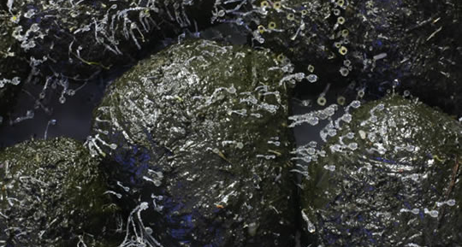
Shotgun Fungus
Notes:
Commonly found in kangaroo dung

Slide 3
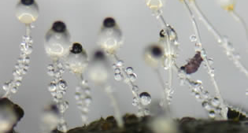
Magnified Shotgun fungi

Slide 4
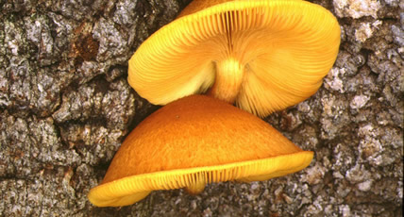
Golden Wood Fungus
Notes:
Extremely common in the Perth region, most often seen on fallen Banksia logs and branches. It is a decomposer fungus occurring on a wide range of rotting logs, stumps and woody debris.

Slide 5
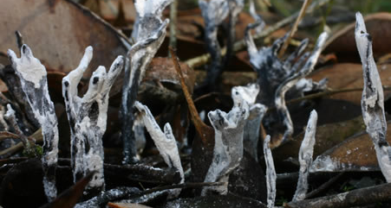
Candle Snuff Fungus
Notes:
Candle Snuff Fungus is a decomposer of wood and is known throughout many parts of Australia and the world. Vary in size up to about 7 cm tall

Slide 6
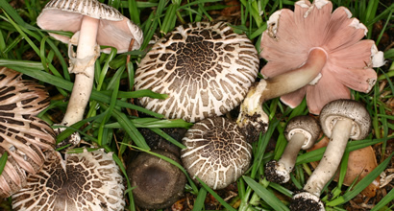
Pinwheel Agaricus
Notes:
This is a mushroom fungus. In 2005 identified for the first time in Perth. Recognised in widely varied habitats and locations within the greater Perth region, including the Swan Coastal Plain and Darling Scarp. Examples of its habitat in Perth include: among uncut grass, leaf litter, and/or woodchips under eucalypts, in humid shade houses, and in leaf litter under exotic trees.

Slide 7
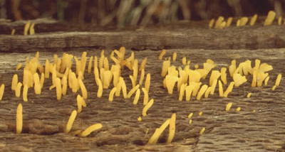
Scotsman's Beard
Notes:
Scotsman's Beard occurs on rotting wood and is often seen in bushlands of the Perth region on logs of Banksia or Eucalyptus particularly during June and July. The individual fingers are mostly up to about 5mm tall and vary in shape.

Slide 8
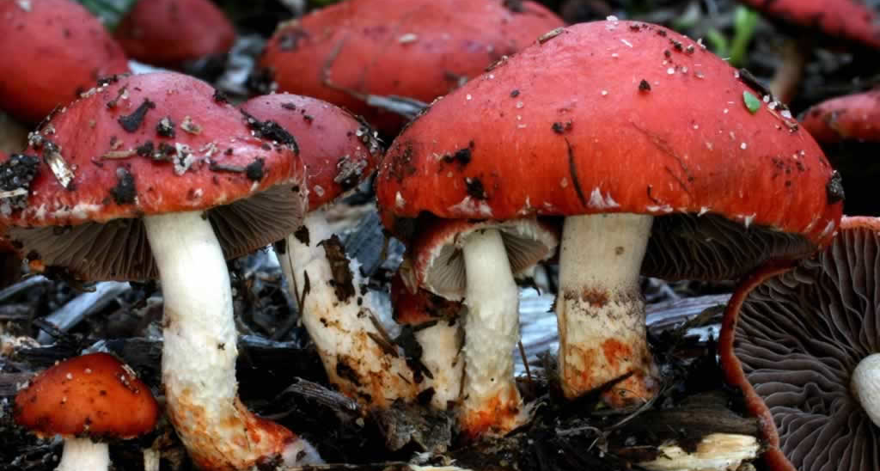
Red Woodchips Fungus
Notes:
The Red Woodchips Fungus occurs in large troops in woodchip beds in parks and gardens throughout the Perth Region. It also occurs throughout Australia and is thought to have been introduced from Australia to many other parts of the world.

Slide 9
