Slide 1
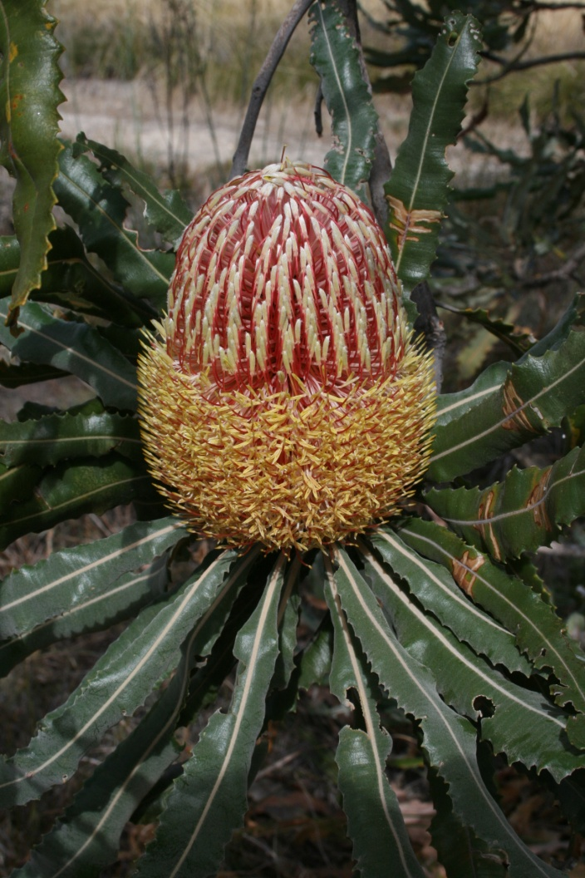
St Emilie’s Banksia Woodland

Slide 2
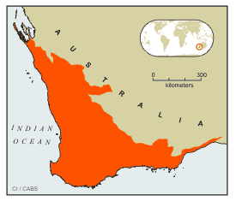
South-west WA An international biodiversity hotspot (one of only 34 hotspots world-wide)
What is a biodiversity hotspot?
1. the area must contain 1500 species that are endemic
2. must have lost at least 70% of its primary vegetation.
SW WA has:
2,948 species of plants
Only 30% natural vegetation left.
http://www.conservation.org/where/priority_areas/hotspots/asia-pacific/Southwest-Australia/Pages/default.aspx

Slide 3
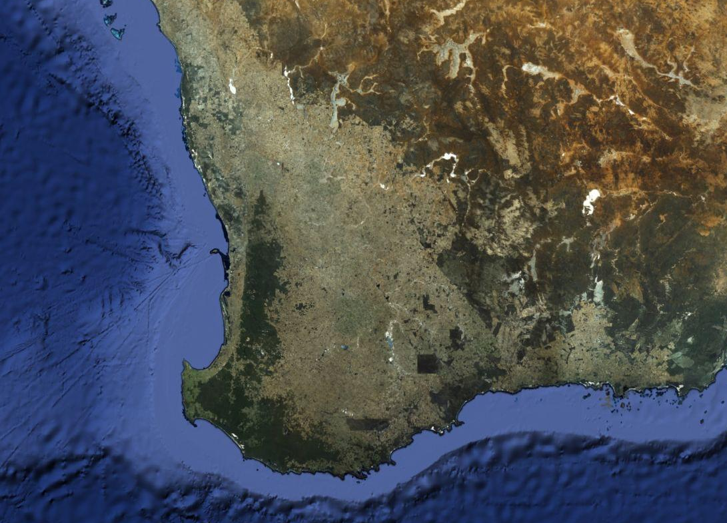
South-west WA
SW Western Australia has a huge “endemic” biodiversity.
It is an ancient landscape.
It is surrounded by desert and oceans making it exist as an “island”.
The climate is dry and the soils are low in nutrients.
There has been extensive landclearing for wheat and sheep grazing.

Slide 4
Perth’s Remnant Bushland
Extensive clearing for houses, roads and industry on the Swan Coastal Plain.
Lack of ecological linkages.
Wetland system in the Canning Vale area.

Slide 5
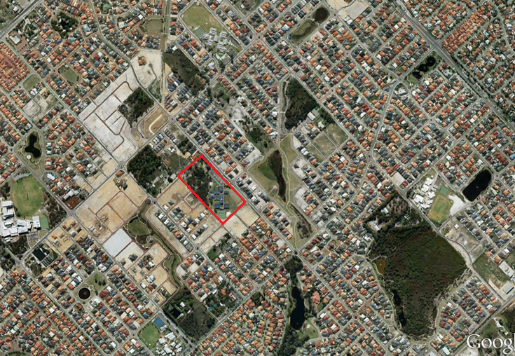
St Emilie’s Banksia Woodland

Slide 6
Banksia – an ancient species

Slide 7
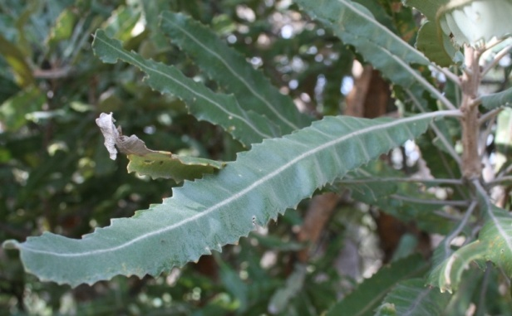
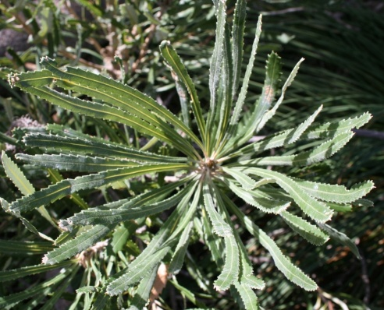
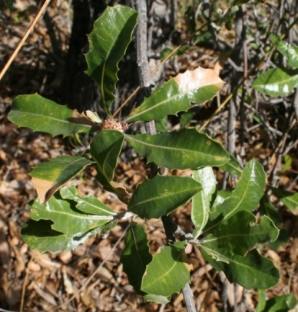
St Emilie’s 3 Banksia Species
Banksia menziesii
(wide leaves)
Banksia attenuata
(thin leaves)
Banksia ilicifolia
(holly leaf)

Slide 8
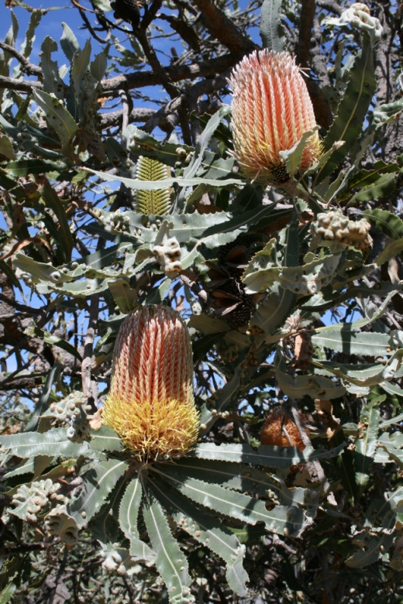
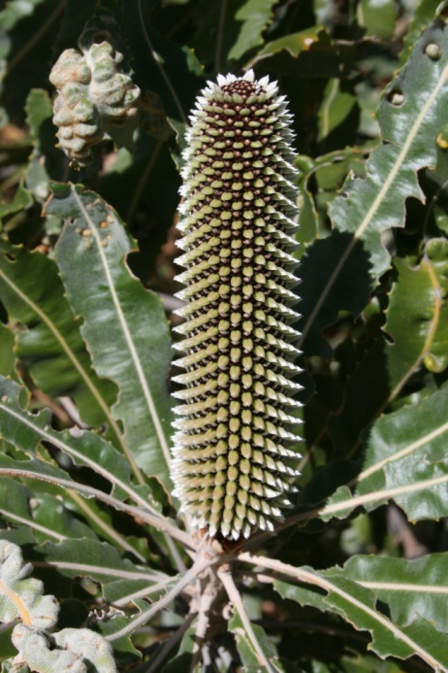
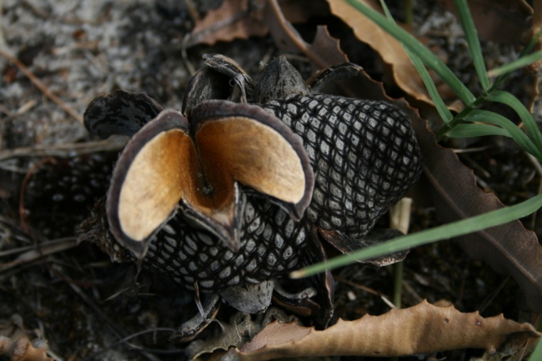
Banksia menziesii
Compound flower
Woody seed cone

Slide 9
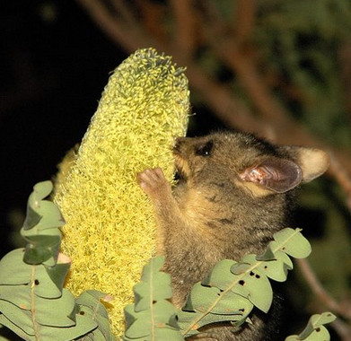
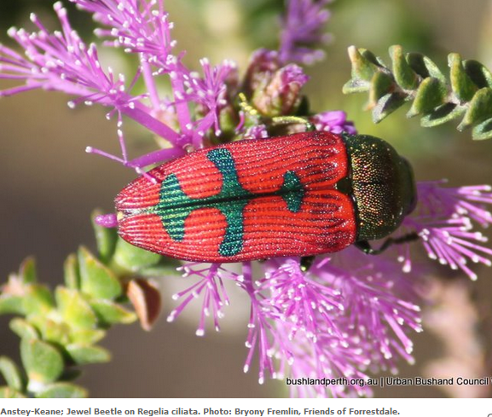
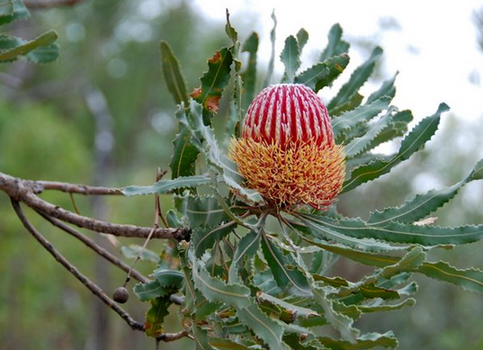
Perth’s Bushland

Slide 10
Bobtail lizard

Slide 11
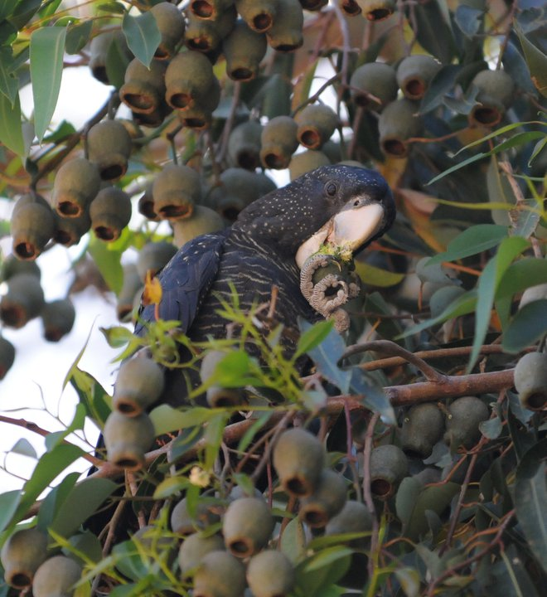
Carnaby’s Black Cockatoo

Slide 12
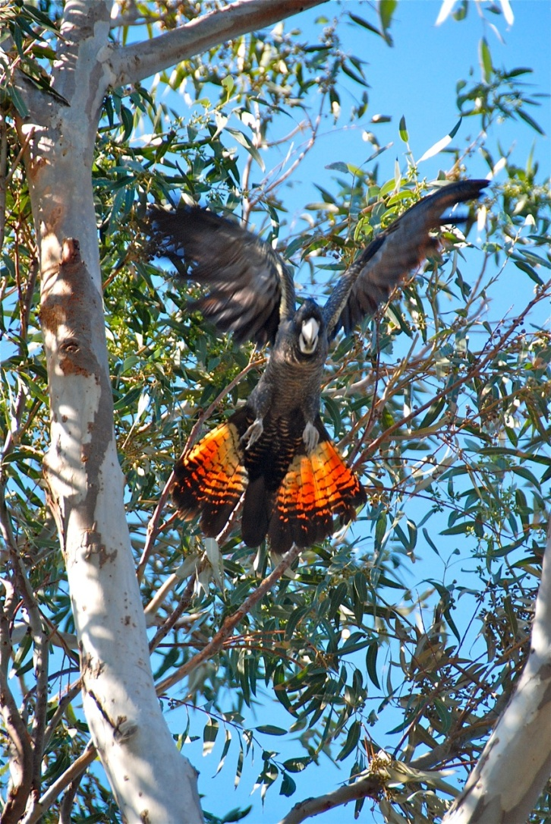
Forest Red-tailed Black Cockatoo

Slide 13
Grass Trees - Xanthorrhea

