Slide 1


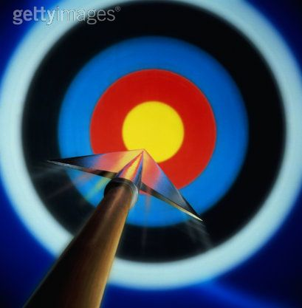


ENERGY
Today’s Target
-State the different types of energy and how it can
be transferred from one form to another
Steps to Success
-State the names of the different energy types –L4b
-Give examples of what energy can be transferred
into– L4a
Path to Progress
-Describe the Law of Conservation of Energy – L5c

Slide 2

CONNECT ACTIVITY
With your partner list as many different types of Energy as you can
Notes:
TEST STUDENTS KNOWLEDGE
GET THEM INTO THEIR SEATS

Slide 3
ACTIVATE
Watch the video clip and try and write down the 10 energy types
ENERGY
Notes:
WATCH THE VIDEO CLIP – BEFORE WATCHING CLIP STUDENTS DRAW SPIDER DIAGRAM
IN THEIR BOOK AND WRITE DOWN THE DIFFERENT TYPES OF ENERGYS THAT THEY SEE

Slide 4
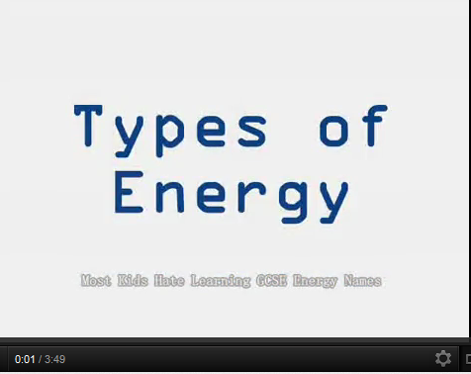
ACTIVATE
http://www.youtube.com/watch?v=kbQc-XUrWvo

Slide 5
DEMONSTRATE
chemical
electrical
sound
ENERGY
heat
kinetic
light
nuclear
magnetic
gravitational
elastic

Slide 6
ACTIVATE
HEAT
CHEMICAL
SOUND
LIGHT and
KINETIC
ELASTIC or
NUCLEAR
ELECTRICAL
GRAVITATIONAL
MAGNETIC
How
Can
Sir
Learn and
Know
Eight or
Nine
Energy
Greats
Majestically
Make up your own rhyme using the first letter of each energy sources

Slide 7
LEARNING OUTCOMES
Today’s Target
-State 10 different forms of Energy – L4
-Understand that energy is not created or
destroyed only transferred into one form or
another – L5
Steps to Success
-State the names of all the different energy types – L4b
-Give examples of where energy comes from – L4a
Path to Progress
-Describe the Law of Conservation of Energy – L5c

Slide 8
DEMONSTRATE
KINETIC
A car is moving (_______ energy)
The engine is hot (______ energy)
The headlights are on( ______ energy)
It is making a lot of noise ( _____ energy).
Inside the car battery are chemicals (_________ energy) which store energy.
There are lots of wires which pass (__________ energy) to the controls.
The car seat is springy (________ energy)
If the car is left on a hill without the handbrake on it will roll down because of (______________ energy).
HEAT
LIGHT
SOUND
CHEMICAL
ELECTRICAL
ELASTIC
GRAVITATIONAL

Slide 9
LEARNING OUTCOMES
Today’s Target
-State 10 different forms of Energy – L4
-Understand that energy is not created or
destroyed only transferred into one form or
another – L5
Steps to Success
-State the names of all the different energy types – L4b
-Give examples of where energy comes from – L4a
Path to Progress
-Describe the Law of Conservation of Energy – L5c

Slide 10
Law of Conservation Of Energy
ACTIVATE
Energy cannot be created or destroyed but can be transferred from one form to another.

Slide 11
LEARNING OUTCOMES
Today’s Target
-State 10 different forms of Energy – L4
-Understand that energy is not created or
destroyed only transferred into one form or
another – L5
Steps to Success
-State the names of all the different energy types – L4b
-Give examples of where energy comes from – L4a
Path to Progress
-Describe the Law of Conservation of Energy – L5c

Slide 12
CONSOLIDATE
What energy is going in?
What energy is coming out?
Sound Energy
Heat Energy
Electrical Energy
Light Energy

Slide 13
CONSOLIDATE
What energy is going in?
What energy is coming out?
Light Energy
Heat Energy
Chemical Energy

Slide 14
CONSOLIDATE
What energy is going in?
What energy is coming out?
Sound Energy
Heat Energy
Electrical Energy
Light Energy

Slide 15
LEARNING OUTCOMES
Today’s Target
-State 10 different forms of Energy – L4
-Understand that energy is not created or
destroyed only transferred into one form or
another – L5
Steps to Success
-State the names of all the different energy types – L4
-Give examples of where energy comes from – L4
Path to Progress
-Describe the Law of Conservation of Energy – L5

Slide 16
ACHIEVE HIGHER

Slide 17
ACHIEVE HIGHER
QUICK QUIZ
Q1. What is the Law of Conservation of Energy?
Q2. What energy change is taking place in an electric fire?
Q3. Which is the useful and wasteful energy in an electric fire?
Q4. What are the 10 different types of energy?

Slide 18
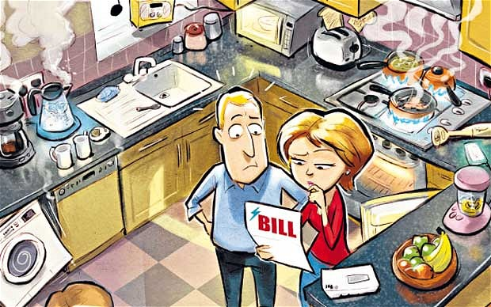
ACHIEVE HIGHER

